Slide 1






REAL TIME CARGO TRACKING
By Team 3

Slide 2
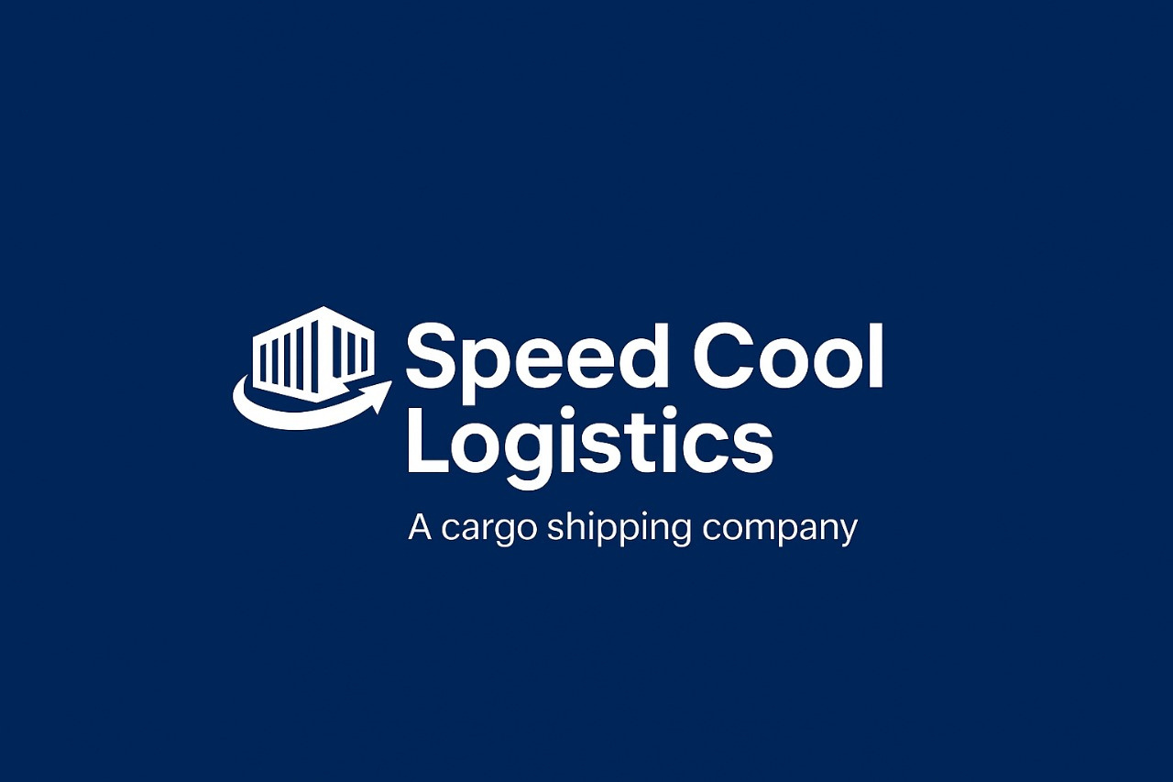

Slide 3
PROBLEM STATEMENT
Current Challenges at Speed Cool Logistics
Lack of a real-time cargo tracking system
Customers don’t know where their cargo is or its exact stage in transit.
No visibility of warehouse location, assigned vehicle/flight, or delivery person.

Slide 4
INTRODUCTION
Modern air logistics faces unpredictable challenges:
Sudden flight path suspensions
Geopolitical tensions impacting routes
Cloud outages disrupting operations
Our project: Speed Cool Logistics
An adaptive, geo-aware, and resilient logistics system
Ensures real-time cargo tracking and dynamic re-routing
Built with multi-cloud failover for uninterrupted service

Slide 5
OBJECTIVE
Ensure uninterrupted cargo tracking and shipment operations
Adapt to sudden route suspensions & geopolitical changes
Provide geo-aware logistics planning
Achieve high availability through cloud failover

Slide 6
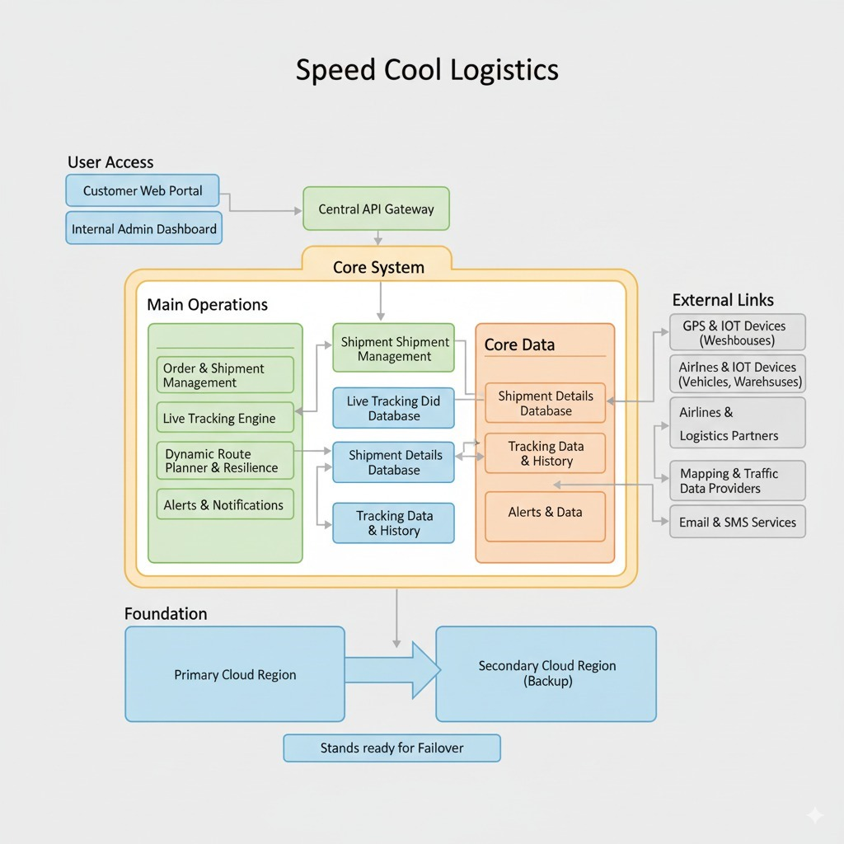
SOLUTION ARCHITECT
Customer App/Website → to track cargo live.
Operations Dashboard → for company staff to monitor shipments.
Delivery App → for drivers/delivery agents to update status.
Backend Systems:
Order system → to create booking & tracking ID.
Warehouse system → shows where cargo is inside the warehouse.
Transport system → links with trucks, flights, and ships.
GPS/IoT tracking → shows real-time location.
Notifications → SMS, app, or email updates at each stage.

Slide 7
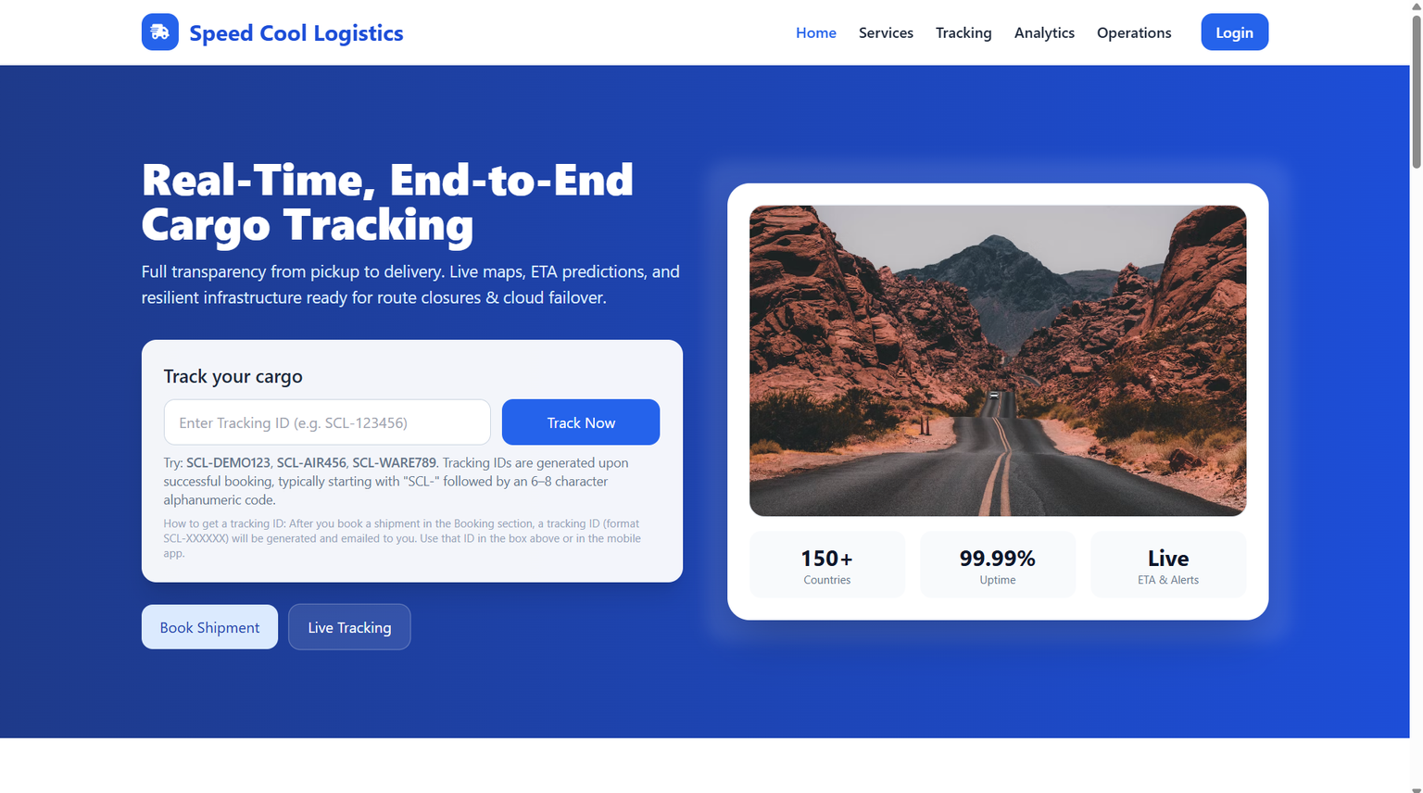

High - Level Design
In this project, We created the official website for start-up company Speed Cool Logistics

Slide 8
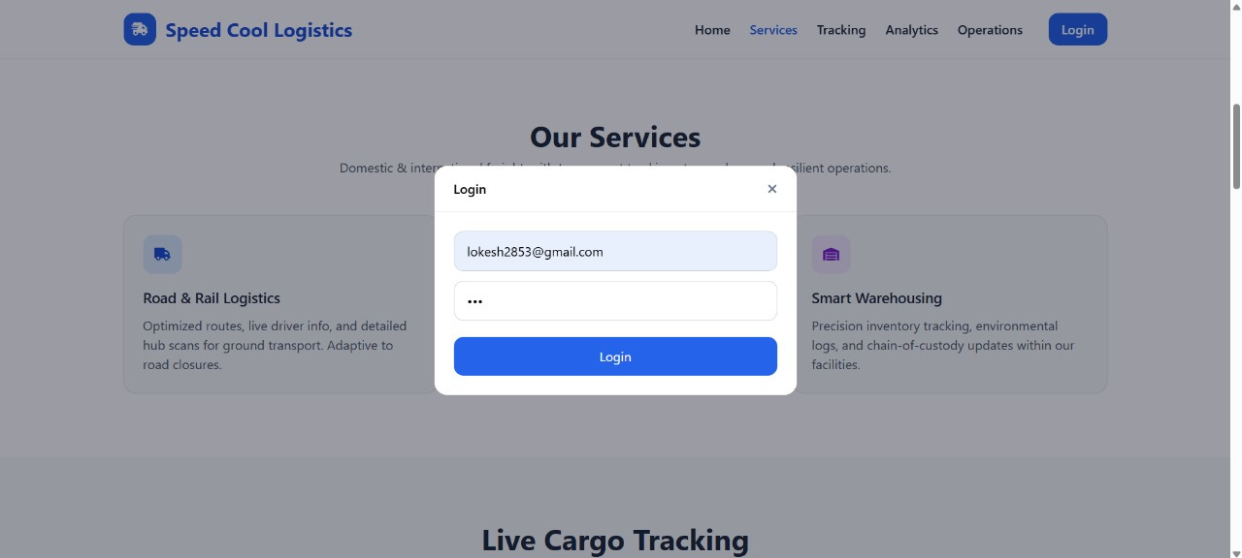

Slide 9
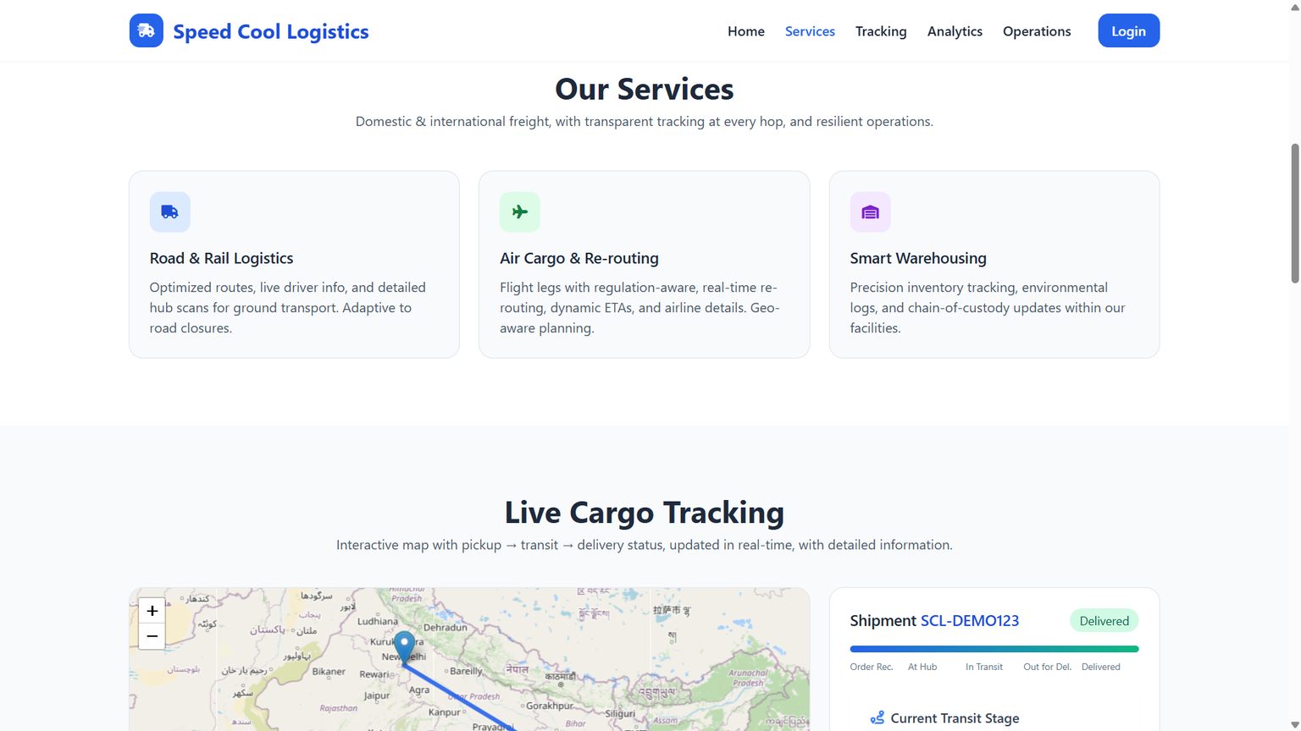
SERVICES PROVIDED

Slide 10
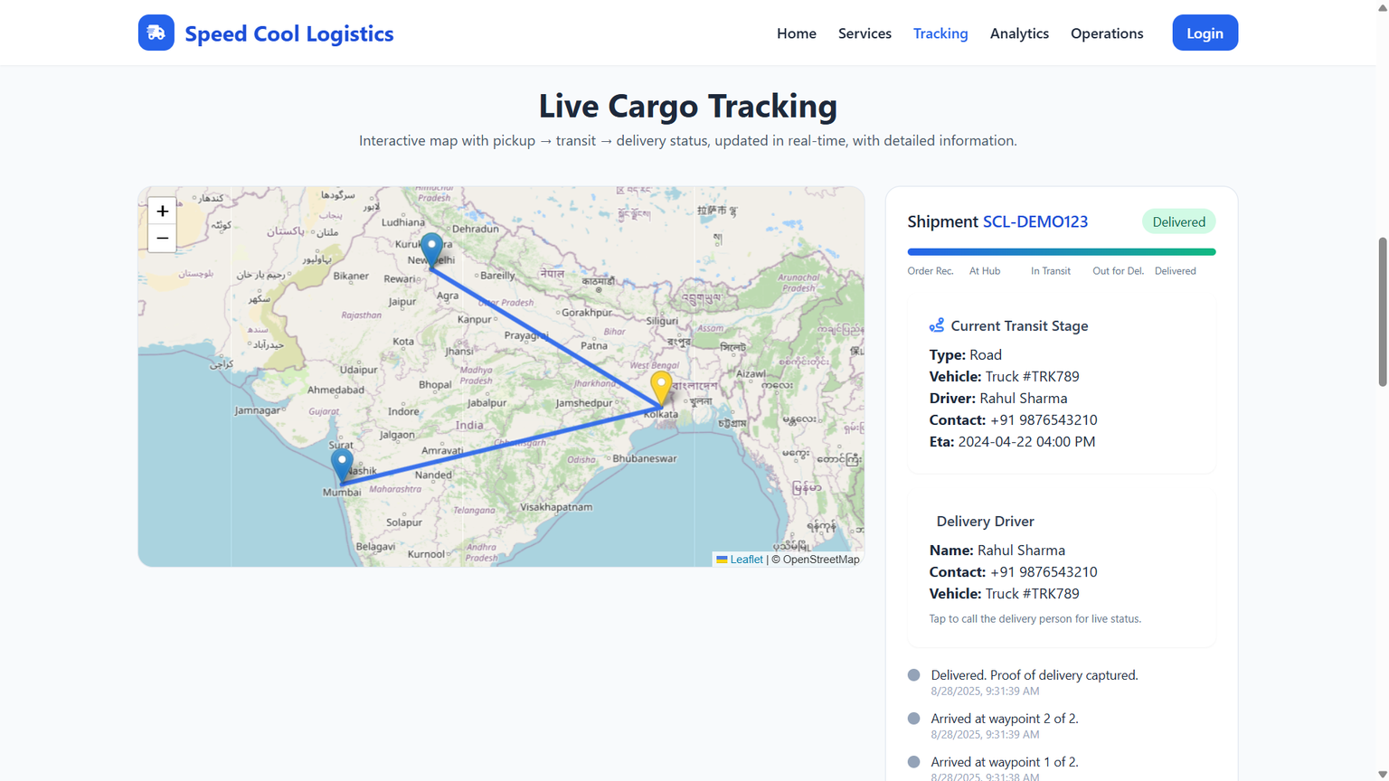
CARGO TRACKING

Slide 11
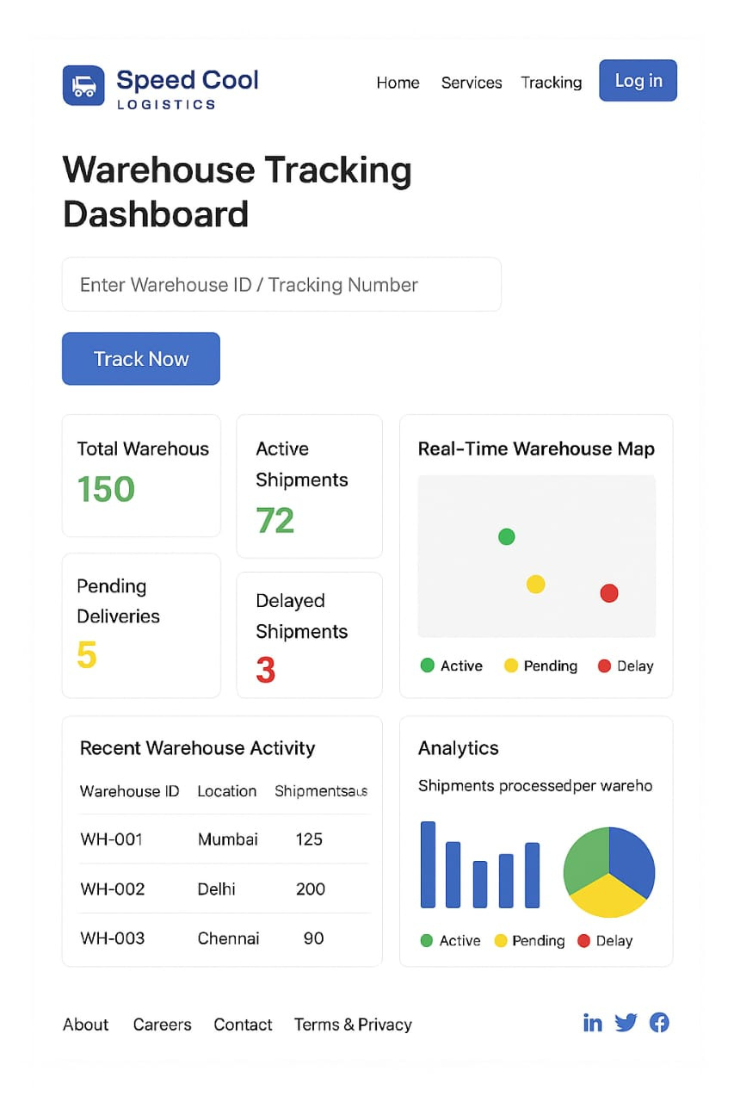
WAREHOUSE TRACKING

Slide 12
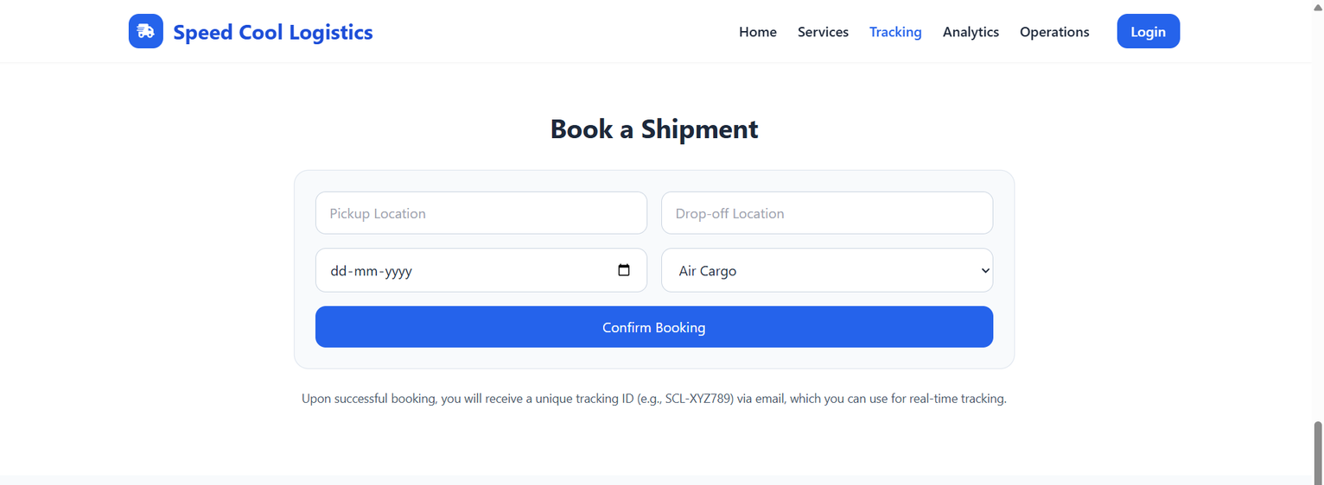
BOOKING A SHIPMENT

Slide 13
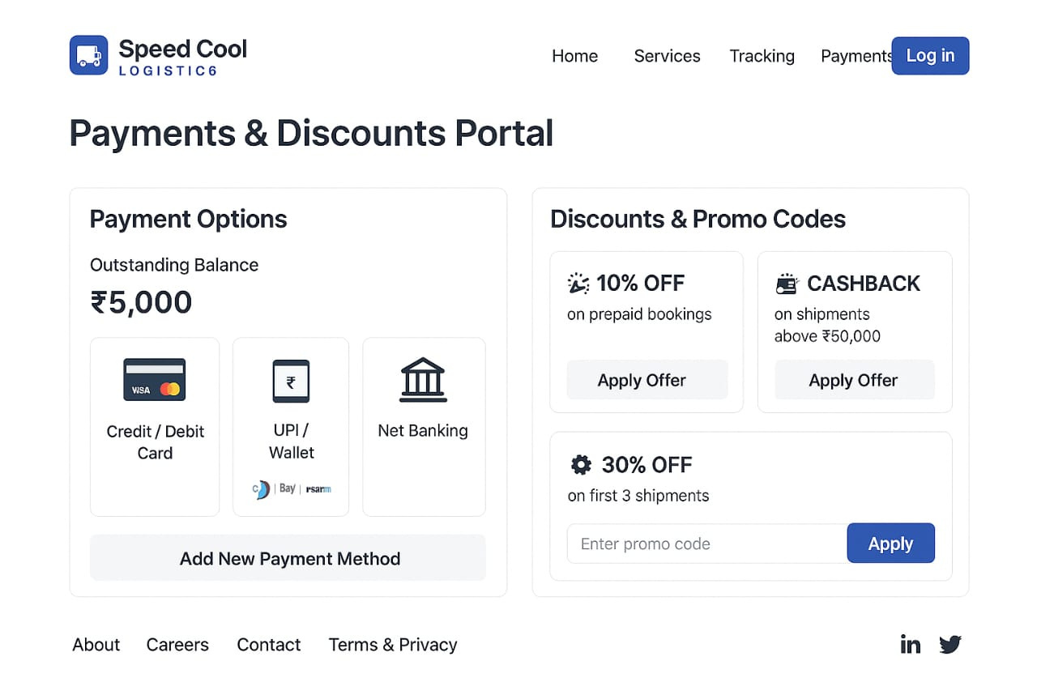
PAYMENT GATEWAY

Slide 14
CHANGES MADE
New Challenges Introduced
Aviation route suspensions due to regulations and geopolitical tensions.
Cloud outage in primary region → service disruption risk.
Re-Architected System Features
High Resilience
Multi-region deployments with automated cloud failover.
Distributed data replication for uninterrupted service.
Geo-Aware Routing
Real-time re-routing of shipments based on sudden flight path closures.
Dynamic selection of alternative routes (sea, land, or air).
Cloud-Failover Ready
Active-active / active-passive architecture across multiple cloud regions.
Automatic traffic redirection to backup infrastructure.

Slide 15

WEBSITE LINK
http://127.0.0.1:5500/index.html

Slide 16
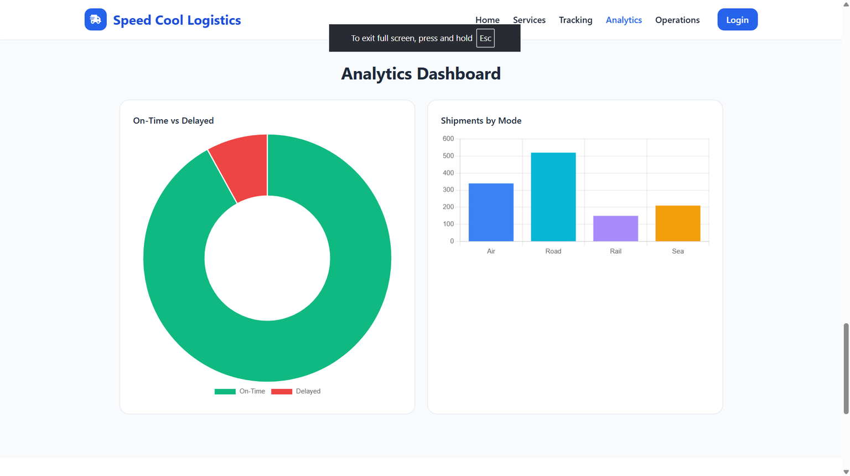
ANALYTICS DASHBOARD

Slide 17
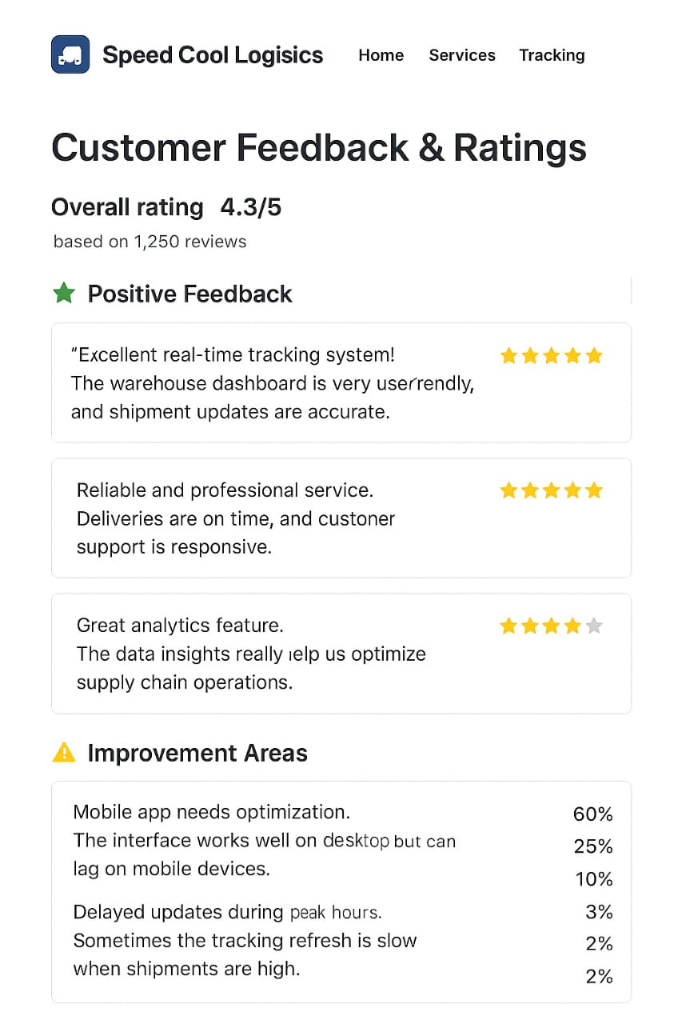
FEEDBACK PAGE

Slide 18
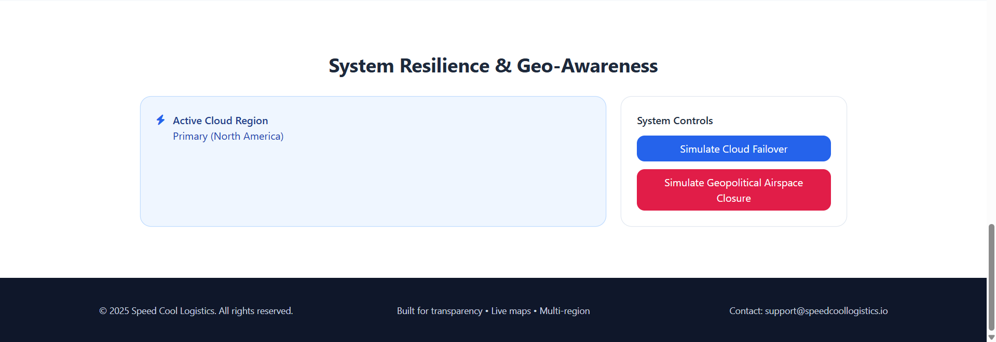
GEO- AWARENESS AND CLOUD FAILOVER

Slide 19
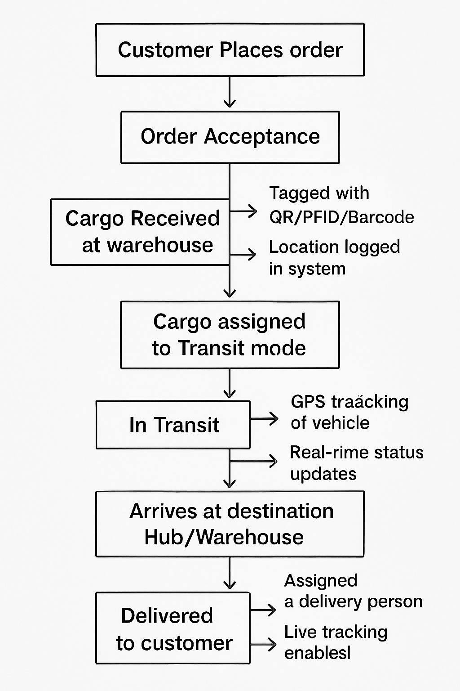
FLOW CHART

Slide 20
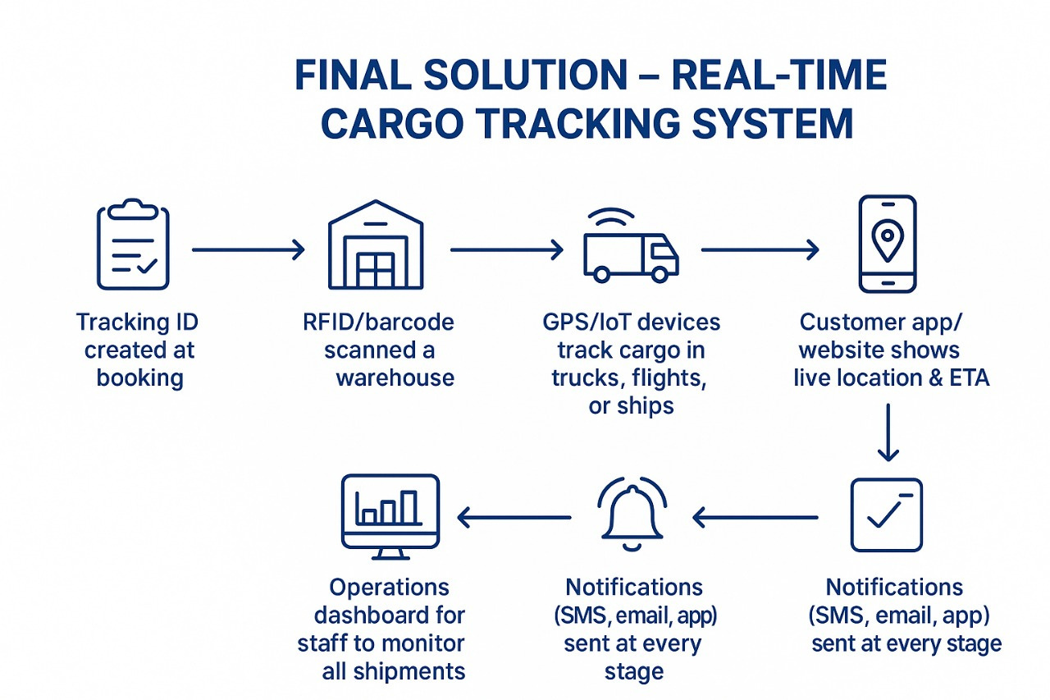
FINAL SOLUTION

Slide 22
THANK
YOU

